Slide 1
MES 2012 - Performance
Module 3:
Performance Model
Contents
Section 1: Modeling Overview
Lab 2: Creating a Galaxy
Section 2: Entity Model Builder
Lab 3: Building the MES Entity Model

Slide 2
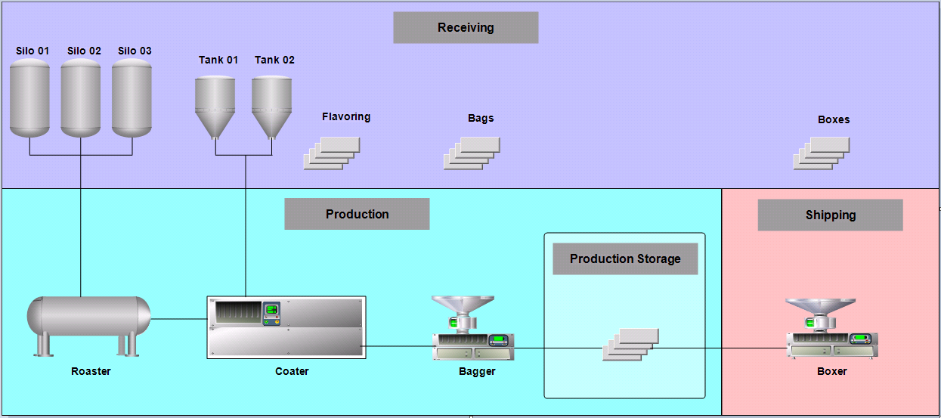
Identify the Process
Mixed Nut Packaging Factory

Slide 3
Lab 2 Creating a Galaxy
Lab Introduction
15 min
In this lab, you will create a base App Server Galaxy, import preconfigured objects, and examine the production plant model in the Galaxy.

Slide 4
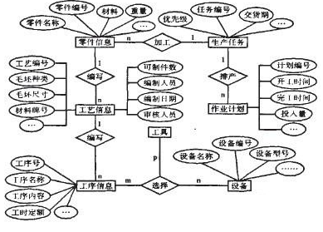
MES Entity
An MES definition representing an equipment used in production
Has assigned Capabilities
Organized in a hierarchy

Slide 5
MES Entity Model
Entity containment relationship
Contains plant area in hierarchical entity chain
Area entity often assigned “Can Schedule Shifts” capability
Consistent with plant modeling in Application Server

Slide 6
Entity Model Builder
A utility in an IDE Extension
Creates entities in MES with the help of UCO, OCO, and SRO (instance)
Builds an entity model in MES based on Application Server Model View

Slide 7
UCO, OCO, and SRO
Provided by MES as object template (.aaPkg)
Help EMB identify entities out of objects
Carry the MES configurations and settings
In runtime, collect production data and communicate with MES middleware service/proxy

Slide 8
Containment of UCO
Me.Att1
Me.BaggerUCO.Att2
Att1
Bagger_001
Me.Att1
Me.BaggerUCO.Att2
Att2
BaggerUCO
Me.Att2
MyContainer.Att1
MyContainer.Motor_001.Att3
Att3
Motor_001

Slide 9
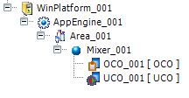
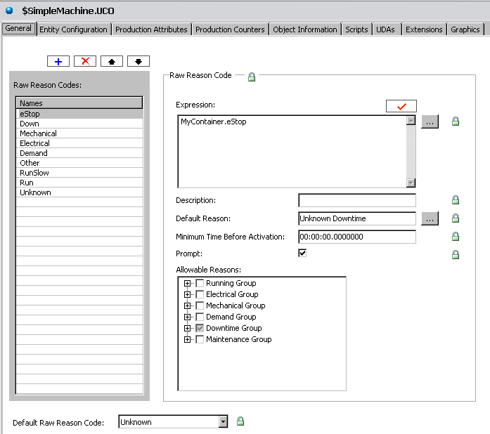
MES – ArchestrA Platform Integration
Facilitates corporate standards
Template approach promotes engineering reuse
Faster configuration and reduced maintenance

Slide 10
Lab 3 Building An MES Entity Model
Lab Introduction
15 min
In this lab, you will:
Import UCO and OCO template objects from MES installation into Application Server Galaxy
Create a UCO and an OCO instance, respectively and contain them in the Bagger object (instance)
Build an MES entity model
Use MES Client to grant the user groups the access permission to the entities

Slide 11
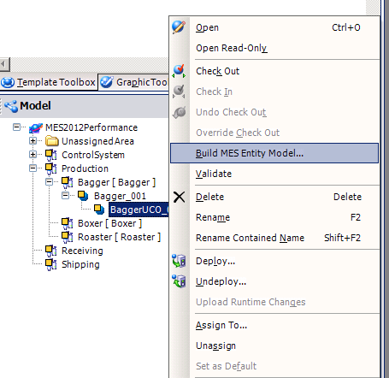
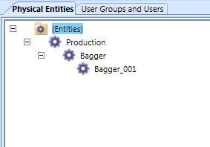
MES Entity Model
The MES entity model ⬄ The Application Server Model View

Slide 12
A² User and Role Export
“Export User and Roles to MES DB…”
A utility in IDE Extension
Security mode must match each other
Galaxy ⬄ Native
OS User ⬄ OS User
OS Group ⬄ OS Group
Roles (ArchestrA) => User Groups (MES)
“Default” role in ArchestrA ignored in MES

