Slide 1
X-Force Report System for Mother Dairy Success Story
Monitoring and reporting made easy…
Reporting System
Web based configuration and Reporting
Output in excel, pdf and web screen
Integrated with DCS, SCADA and other data source supporting ODBC/OPC.
InfoTech

Slide 2
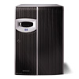
General System Architecture
X-Force XRS
Server
E-Mail
Server
Source Data Providers
Campus
Network
Firewall
Internet
Web Clients on LAN
WAP Client

Slide 3
Mother Dairy Architecture
E-Mail
Server
Reporting
Server
Foxboro DCS
Campus
Network
Firewall
Internet
Web Clients on LAN
Firewall
WAP Client

Slide 4
Mother Dairy
Logical Connectivity
DCS OPC Server
Tunneler Server
DCS System
Firewall
Tunneler Client
Reporting Server
Sync Manager
Historian
SQL Database
Scheduler and Web Portal
Client PC
Email
(Reports in excel or PDF)
Browser
(Report and Live data)
Excel
(Report and Trends)

Slide 5
XRS Architecture
SQL/ ORACLE/ OPC/ ODBC/ /MS ACCESS / Historians
SOURCE
Sync Manager
Report Scheduler
X-Force Historian
Database
Report Mailer
X-Force Excel Add In
Web Portal For Reporting and Dashboards

Slide 6
Dashboards

Slide 7
Plant Dashboard

Slide 8
Dashboard - Charts

Slide 9
Dashboard - Charts

Slide 10
Dashboard - Charts

Slide 11
Six Sigma Graphs for pasteurizer

Slide 12
Pasteurization Process Timing Chart

Slide 18
Bell Curve

Slide 19
CIP Timings

Slide 22
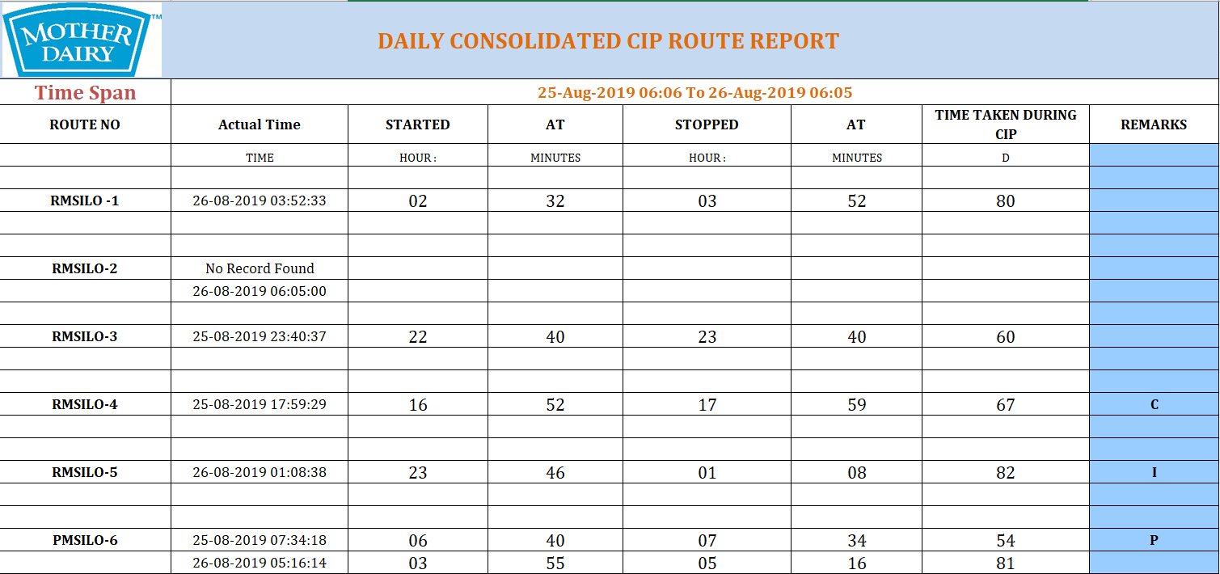

Slide 23
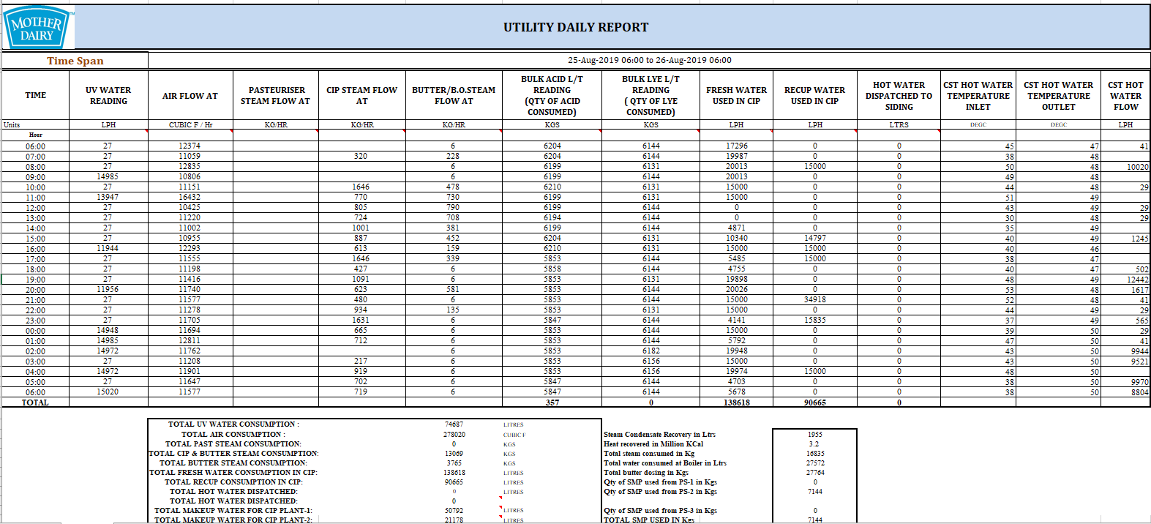

Slide 24
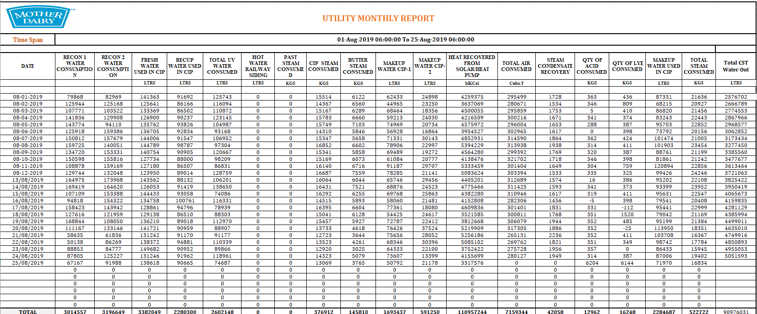

Slide 25
Plant parameter Report

Slide 26
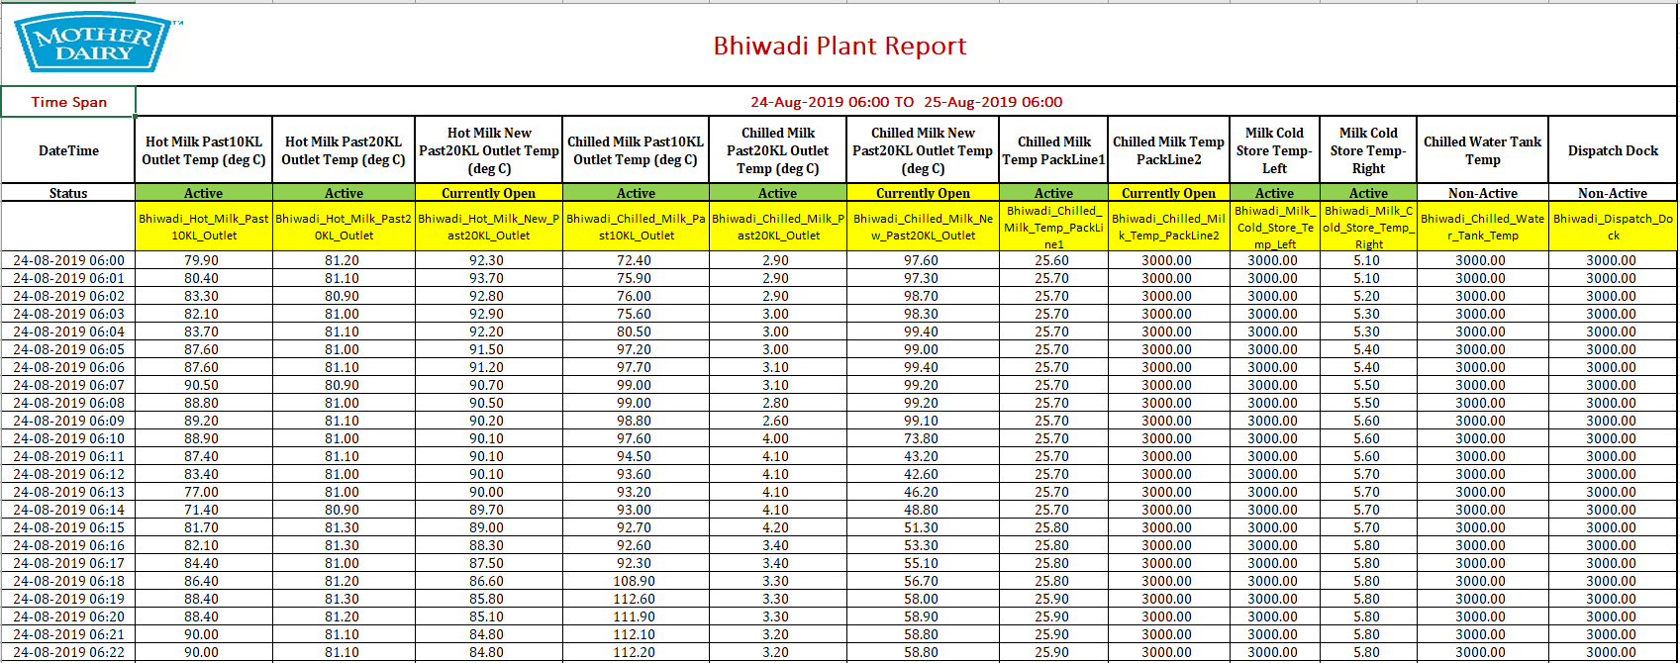

Slide 27
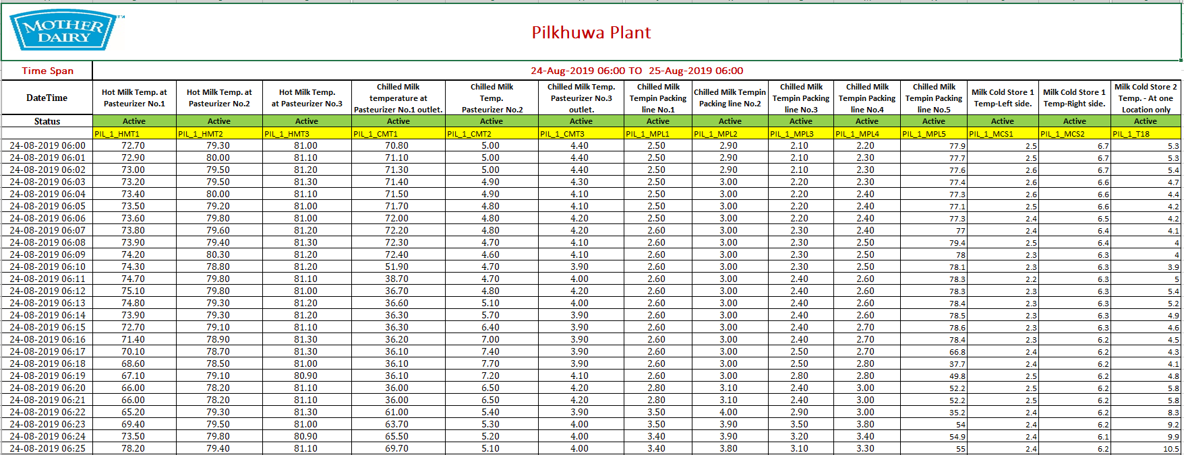

Slide 28
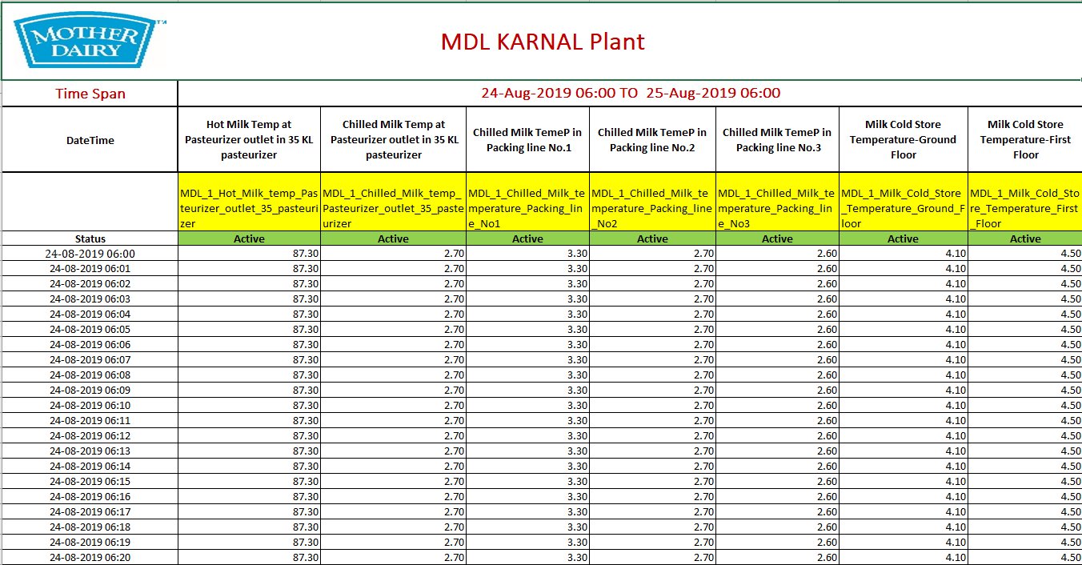

Slide 29
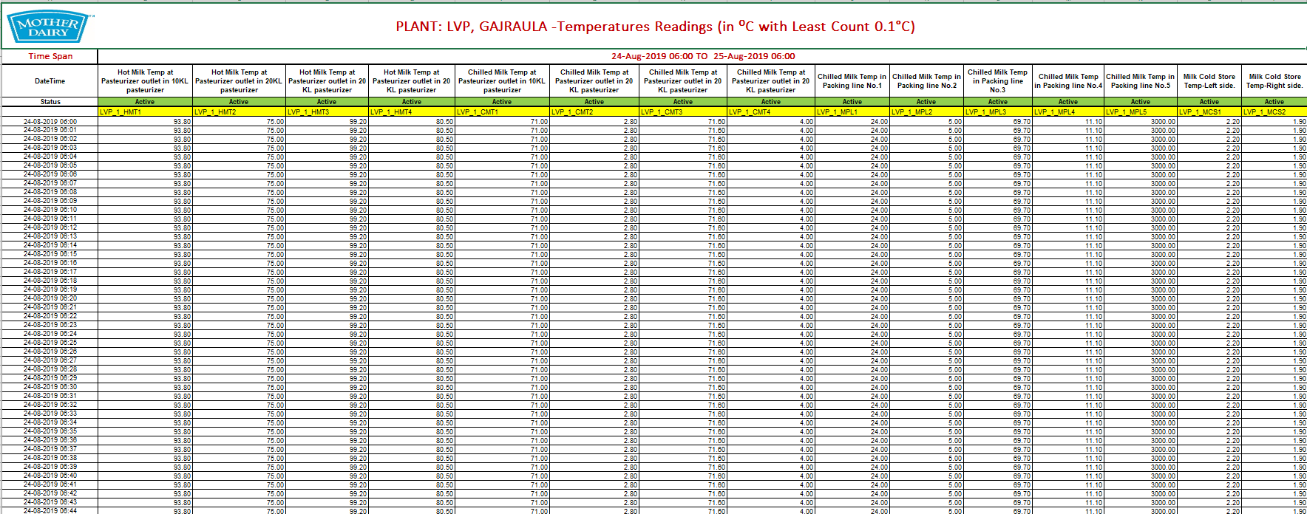

Slide 30
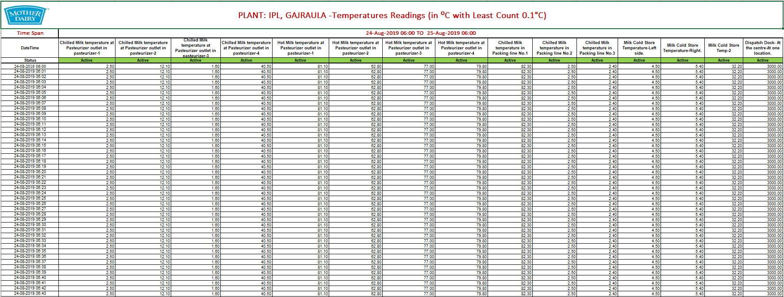

Slide 31
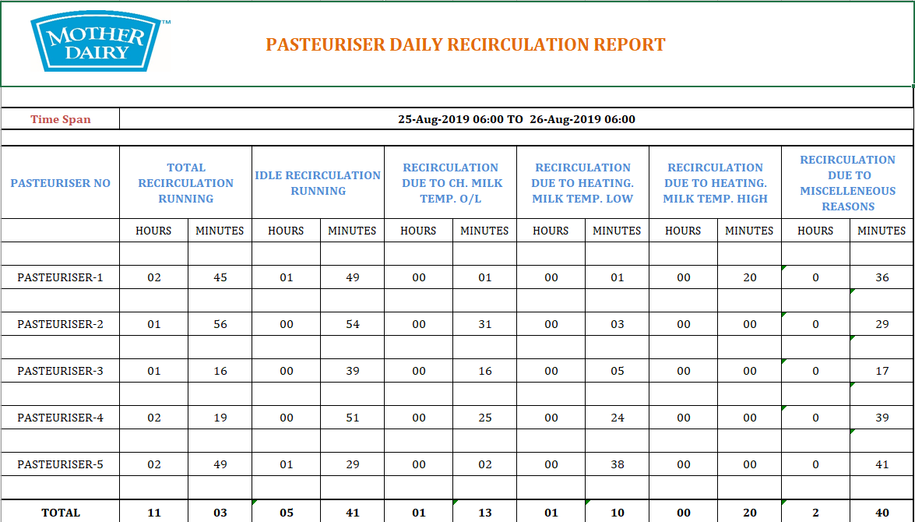

Slide 33
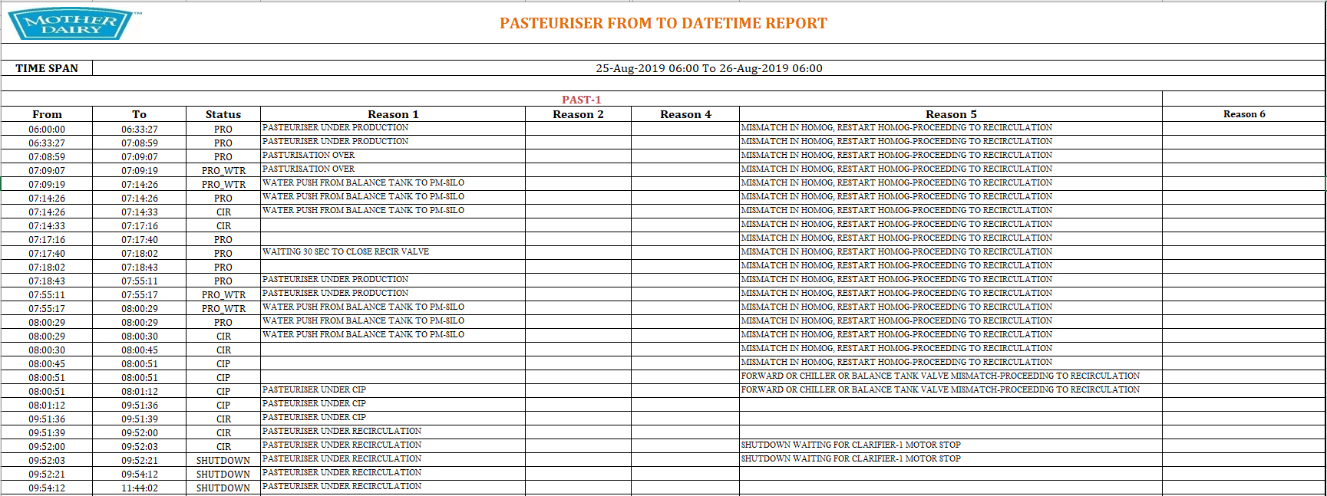

Slide 34
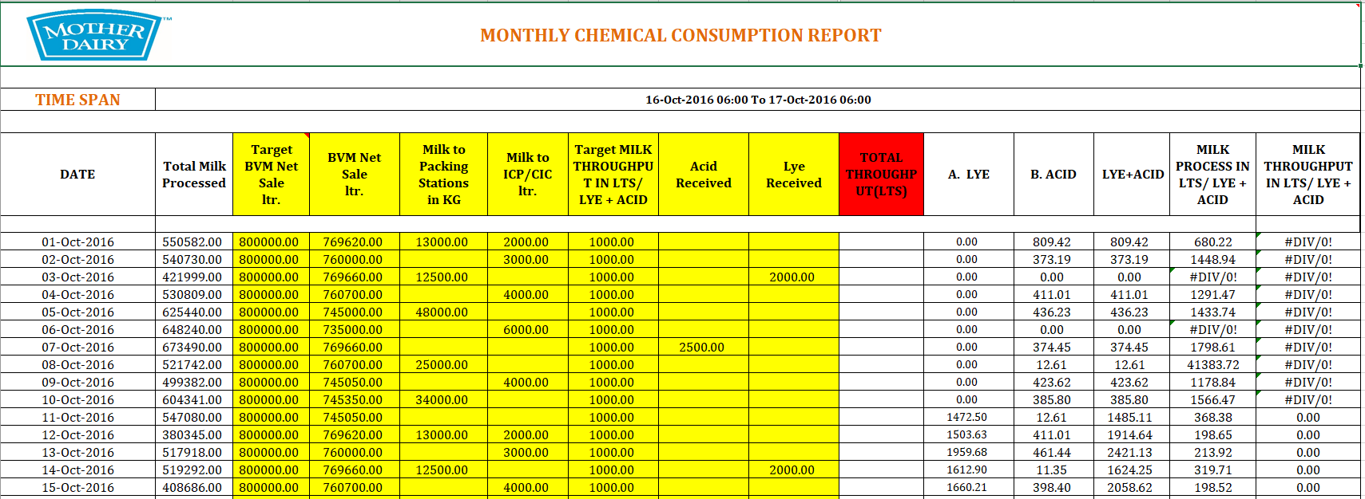

Slide 35
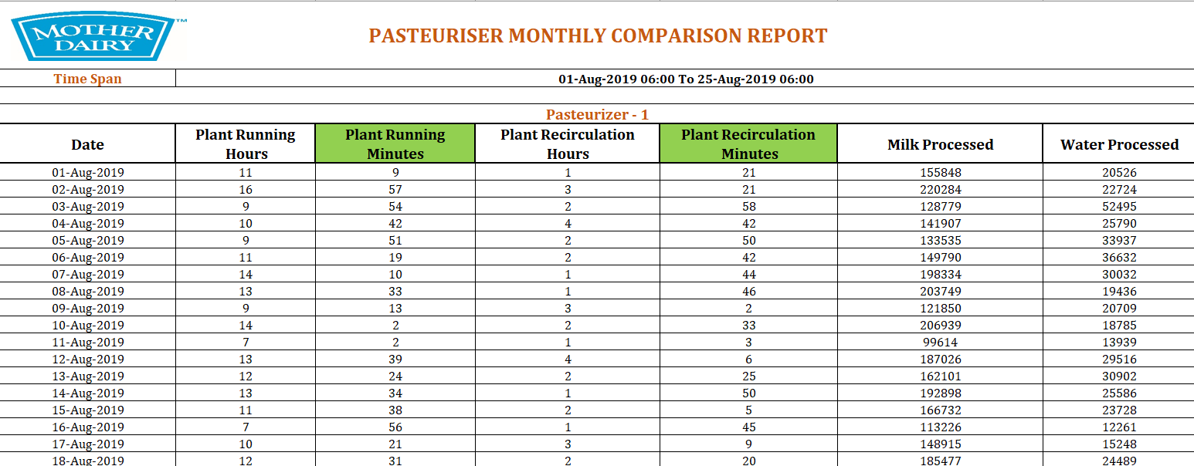

Slide 36
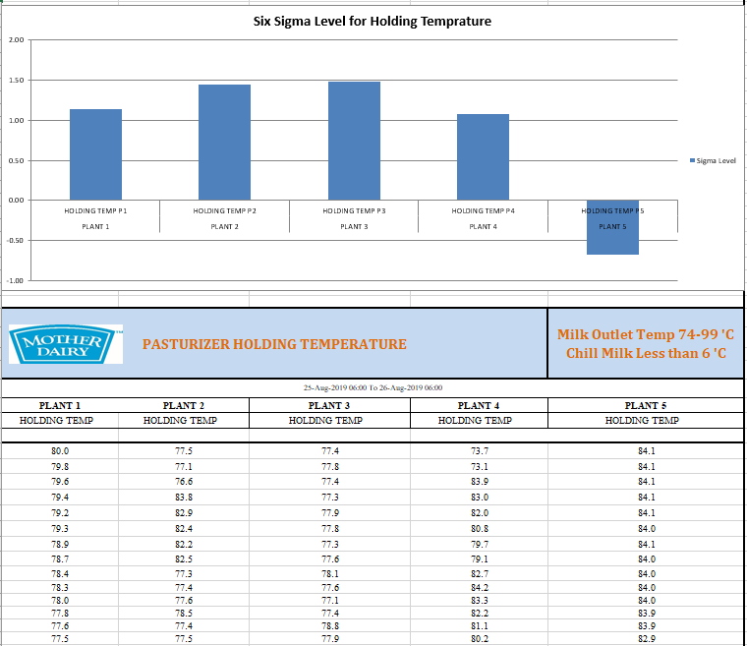

Slide 37
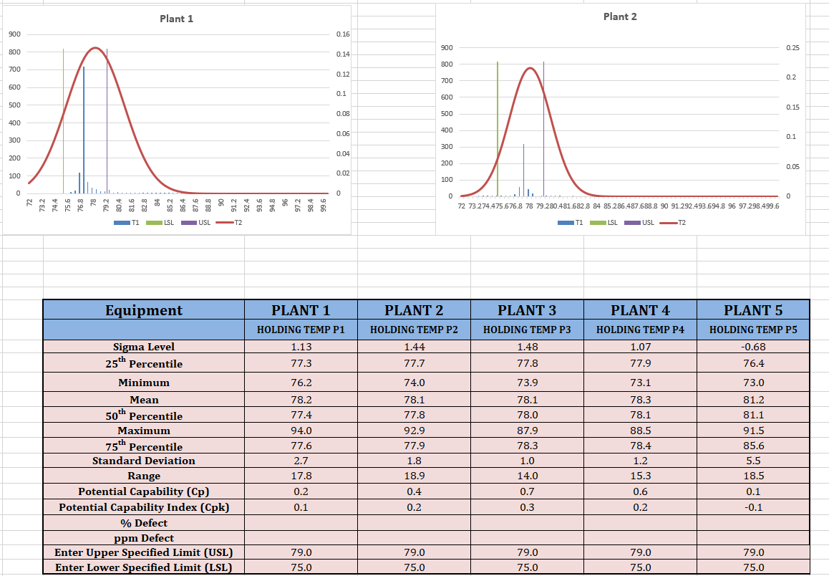

Slide 38
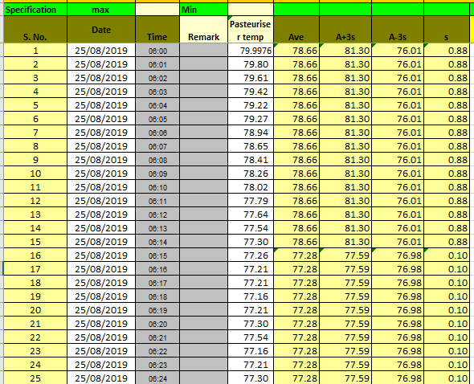
Control chart for holding Temperatures

