Slide 1
Modbus and TCP Modbus Protocol
Modbus Request and Response Query

Slide 2
Modbus Protocol
The Modbus devices communicate using a master-slave technique, in which only one device (the master) can initiate transactions(called ‘queries’). The other devices (the slaves) respond by supplying the requested data to the master, or by taking the action requested in the query.
The master can address individual slaves, or can initiate a broadcast messages to all slaves. Slaves return a message(called a ‘response’) to queries that are addressed to them individually. Responses are not returned to broadcast queries from the master.
In EMS master is a X-Force DAS Software and slave is a energy Meter

Slide 3
Modbus Protocol
Modbus Read Request Query(8 Byte) (Holding and Input Register)
Slave Address | Function Code | Starting Address | No of register | CRC
1 Byte | 1 Byte | 2 Byte | 2 Byte | 2 Byte
1 | 3 | 3901 | 10

Slide 4
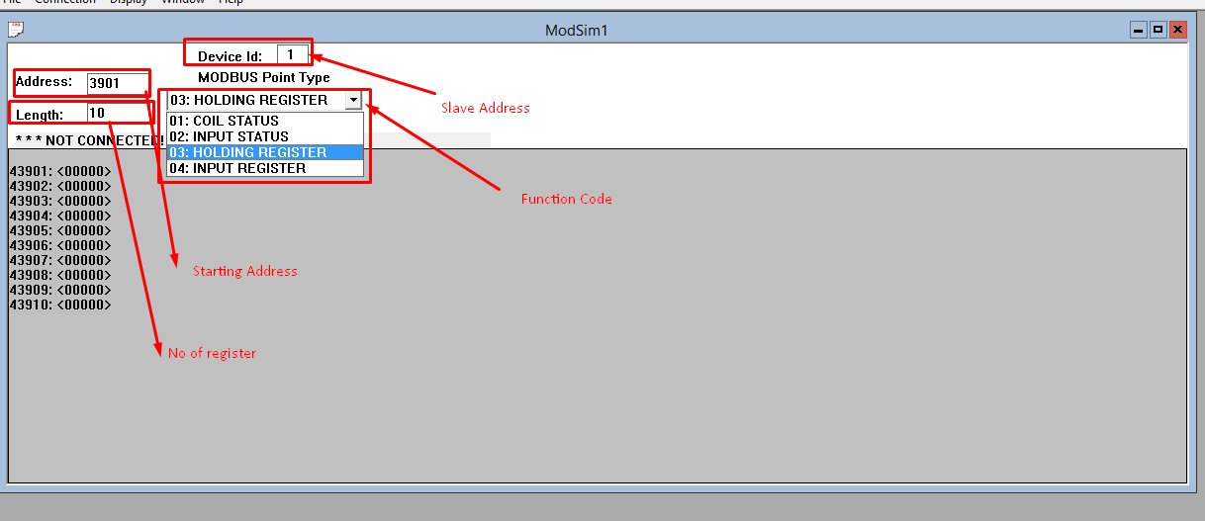
Mod Simulator

Slide 5
Modbus Protocol
Modbus Read Response Query(5 Byte + No of Register * 2) (Holding and Input Register)
Slave Address | Function Code | Byte Count | Data=No of register * 2 | CRC
1 Byte | 1 Byte | 1 Byte | 10 Register * 2 =20 Byte | 2 Byte
1 | 3 | 20

Slide 6
DAS Serial Communication

Slide 7
TCP Modbus Protocol
TCP Modbus Read Request Query(12 Byte) (Holding and Input Register)
Transaction ID | Protocol ID | Length | Slave Address | Function Code | Starting Address | No of register
2 Byte | 2 Byte | 2 Byte | 1 Byte | 1 Byte | 2 Byte | 2 Byte
0-65535 | 0 | 6 | 1 | 3 | 3901 | 10

Slide 8
TCP Modbus Protocol
TCP Modbus Read Response Query(12 Byte) (Holding and Input Register)
Transaction ID | Protocol ID | Length | Slave Address | Function Code | Byte Count | Data
2 Byte | 2 Byte | 2 Byte | 1 Byte | 1 Byte | =No of register*2 Byte | No of register * 2 Data Byte
0-65535 | 0 | 6 | 1 | 3 | =10*2=20 | 20 Byte data

Slide 9
TCP Modbus Protocol
Just add three parameter like Transaction ID, Protocol ID, Length and Remove CRC parameter from TCP Modbus Protocol.

Slide 10
Kalpesh Mangukiya
Thank you ☺

