Slide 1
MES 2012 - Performance
Module 5:
Overall Equipment Effectiveness
Contents
Section 1: OEE Overview
Section 2: Shifts and Shift Schedules
Lab 8: Configuring Shift Schedules
Section 3: UCO and OCO Configuration for OEE Calculation
Lab 9: Tracking OEE

Slide 2
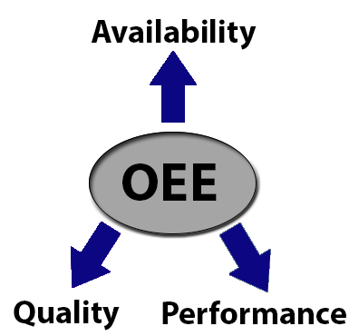
Overall Equipment Effectiveness
In Wonderware MES Performance, OEE calculation is based on the industry standard OEE methodology. The OEE calculation is a product of an entity’s Availability, Performance, and Quality efficiencies over a given interval (for example, a Shift)
OEE% = Availability% * Performance% * Quality%
Availability% = Run Time / Net Operating Time
Performance% = Total Output / Target Output
Quality% = Good Output / Total Output

Slide 3
OEE Calculation
Overall Equipment
Efficiency (OEE)
=
Availability
Performance
Quality
x
x
One Shift
Available Time
Not Scheduled (Lunch, Meeting)
Running Time
Down Time
Availability% =
Available Time – Down Time
Available Time
Target (Design) Capacity
Actual Capacity
Speed Losses
Performance% =
Total Production _
Target Rate x Run Time
Good Production
Bad Production
Quality% =
Total Production – Rejects
Total Production

Slide 4
Shift and Shift Schedule
Shifts are user-defined names or labels used for OEE tracking
Shift Schedules define available time between a time period for OEE Availability calculation

Slide 5
Lab 8 Configuring Shift Schedules
Lab Introduction
10 min
In this lab, you will:
Add “Production” entity to the Shift and Shift Schedule list
Create “Day” shift schedules

Slide 6
UCO – Production Attributes
A Work Order is needed
Batch Size cannot be zero
Target Job Production Rate is needed
Use .ProdAttrs.StartJobCmd and .ProdAttrs.EndJobCmd to start/stop a job
Use .ProdAttrs.ErrorCode and .ProdAttrs.ErrorMessage to monitor runtime error

Slide 7
OCO – Counters
Each Counter must be tied to a Production Reason
Each Counter has one absolute and one incremental counter attribute
Dead Band only applies to incremental counter
Use .CounterX.ErrorCode and .CounterX.ErrorMessage to monitor runtime error

Slide 8
Lab 9 Tracking OEE
Lab Introduction
30 min
In this lab, you will:
Add and configure product counters in OCO template
Simulate product’s Good Count and Bad Count from an InTouch window
Track and verify OEE calculation

