Slide 1
6
Steps, Specifications, and MES Attributes

Slide 2
Wonderware MES 4.0 - Operations
Module 6:
Steps, Specifications, and MES Attributes
Contents
Section 1: Operation Steps
Lab 16 – Tracking Operation Steps
Section 2: Specifications
Lab 17 – Managing Specifications
Section 3: MES Attributes
Lab 18 – Adding MES Attributes

Slide 3
Operation Steps
Step
1,n
Steps Group
1,n
BOM Version
1,n
BOM Component
1,n
Item
1,n
Item Class
1,n
Operation
1,n
Process
1,n
Process Class
1,n
Entities
1,n
Sched Jobs
Run Jobs

Slide 4
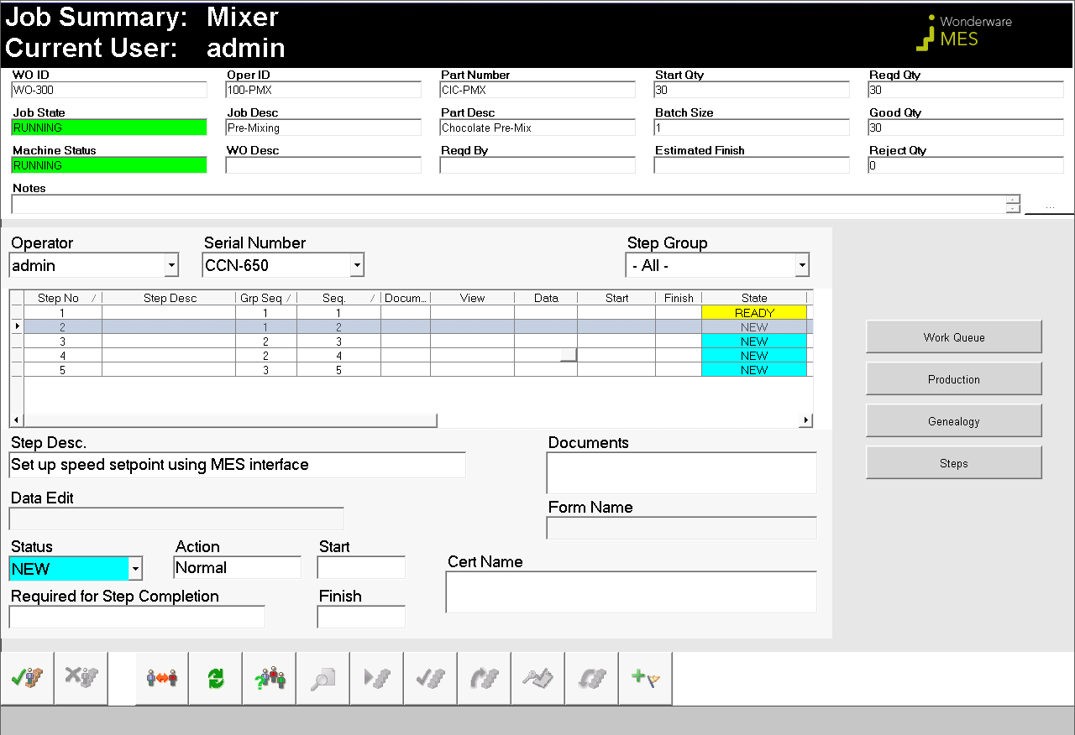
Lab 16 Tracking Operation Steps
35 min

Slide 5
Specifications
Global
Spec
1,n
Step
1,n
Steps Group
1,n
BOM Version
1,n
BOM Component
1,n
Spec
1,n
Spec Group
1,n
Item
1,n
Item Class
1,n
Operation
1,n
Process
1,n
Process Class
1,n
Entities
1,n
Sched Jobs
Run Jobs

Slide 6
Specifications
MES DB
Op100
Job in
Station1
Job in
Station1
Working
Space
Load Cmd
Save Cmd
Working.SpecValue
Working.SpecValueActual
OCO
Target
Space
Download Cmd
Upload Cmd
Target.SpecValue
Target.SpecValueActual
Plant Floor
Controllers

Slide 7
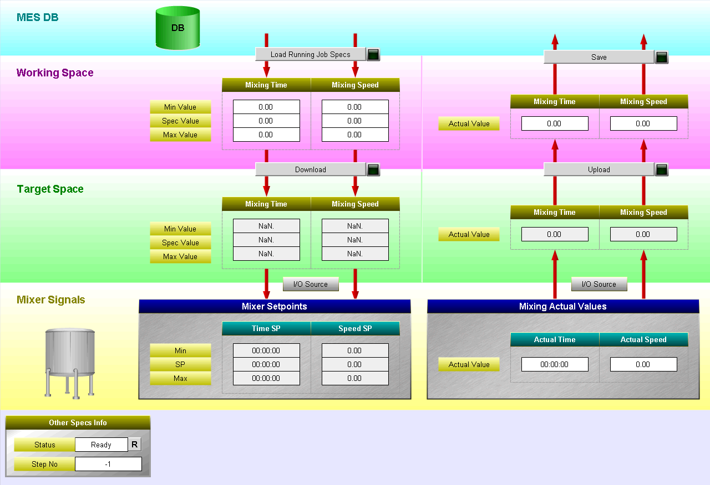
Lab 17 Managing Specifications
45 min

Slide 8
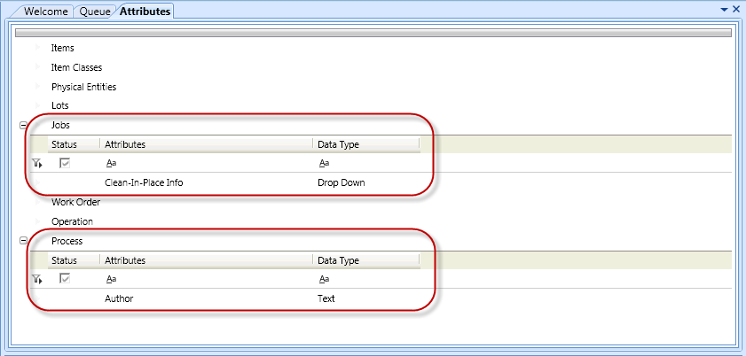
Lab 18 Adding MES Attributes
20 min

