Slide 1
MES 2012 - Performance
Module 7:
Reports
Contents
Section 1: ArchestrA Reports

Slide 2
MES Reports Deployment
MES Reports are published to Information Server during MES Setup

Slide 3
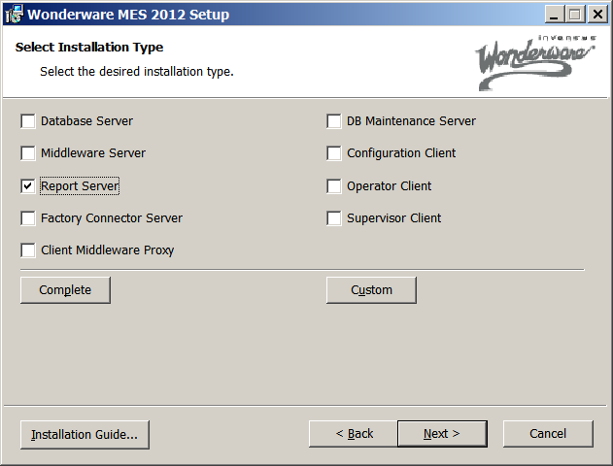
MES Reports Deployment

Slide 4
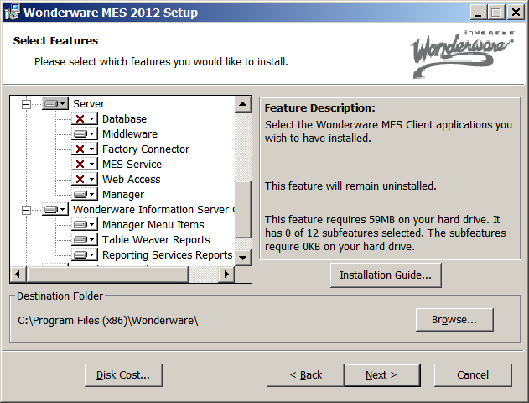
MES Reports Deployment

Slide 5
MES Performance Reports
ArchestrA Reports
Downtime Analysis
OEE Analysis
OEE by Shift Trend
OEE Details

