Slide 1
5
Operator Visualization

Slide 2
Wonderware MES 4.0 - Operations
Module 5:
Operator Visualization
Contents
Section 1: MES Operator Client
Lab 14 – Manually Tracking Work Orders
Section 2: MES .NET Controls
Lab 15 – Using Wonderware MES .NET Controls

Slide 3
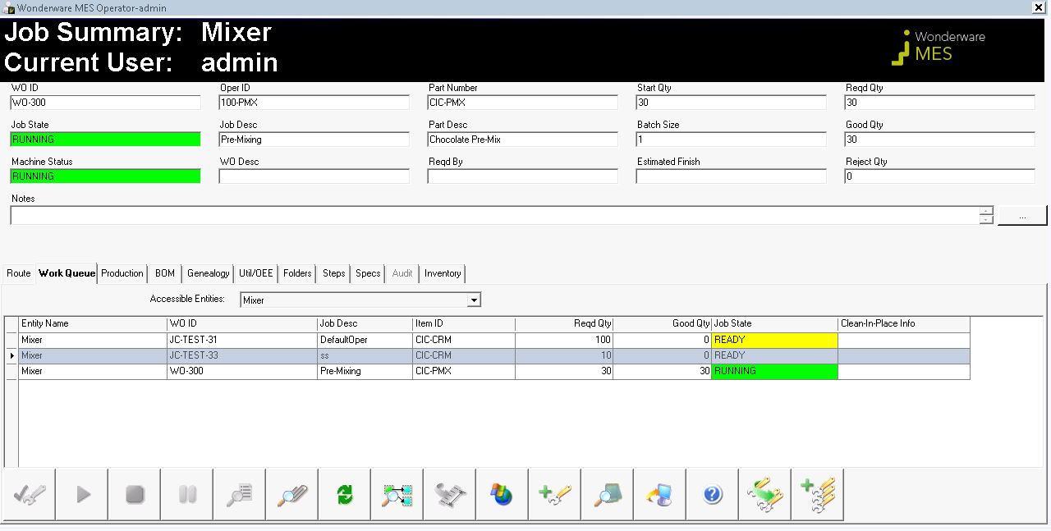
Lab 14 Manually Tracking Work Orders
40 min

Slide 4
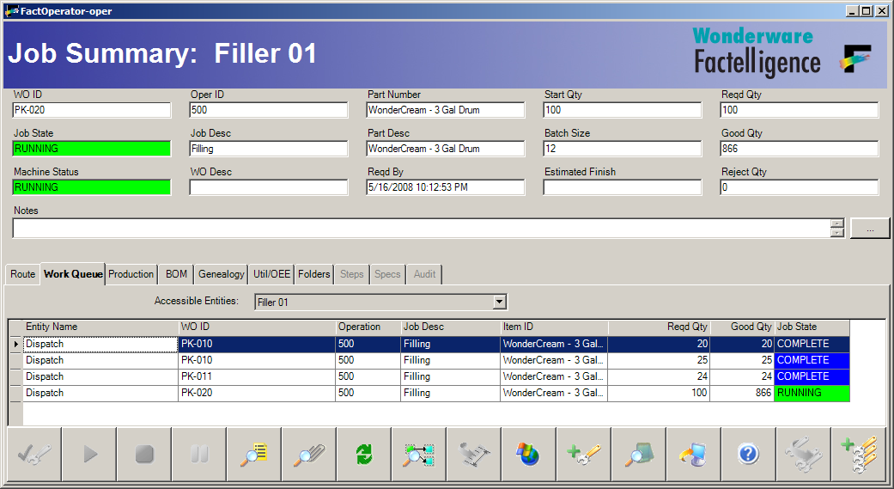
.NET Controls
File
FactMES.Controls.JobSummary
File
Fact.Controls.ButtonBar
Tab | File
Route | FactMES.Controls.Route
Work Queue | FactMES.Controls.Queue
Production | FactMES.Controls.Production
BOM | FactMES.Controls.Consumption
Genealogy | FactMES.Controls.Genealogy
Util/OEE | FactMES.Controls.Utilization
Labor | FactMES.Controls.BulkLabor
Tab | File
Folders | FactMES.Controls.Folders
Steps | FactMES.Controls.Steps
Specs | FactMES.Controls.Spec
Data Log | FactMES.Controls.DataLog
Audit | FactMES.Controls.Audit
Inventory | FactMES.Controls.Inventory

Slide 5
Linking the Button Bar Control
Control C1
C1.ButtonBarName = B1
Button Bar B1
B1.ControlInCharge = C1
B1.ShowAllControlsButton = False

Slide 6
Linking the Button Bar Control
Control C1
Control C2
C1.ButtonBarName = B1
C2.ButtonBarName = B1
Button Bar B1
B1.ShowAllControlsButton = True

Slide 7
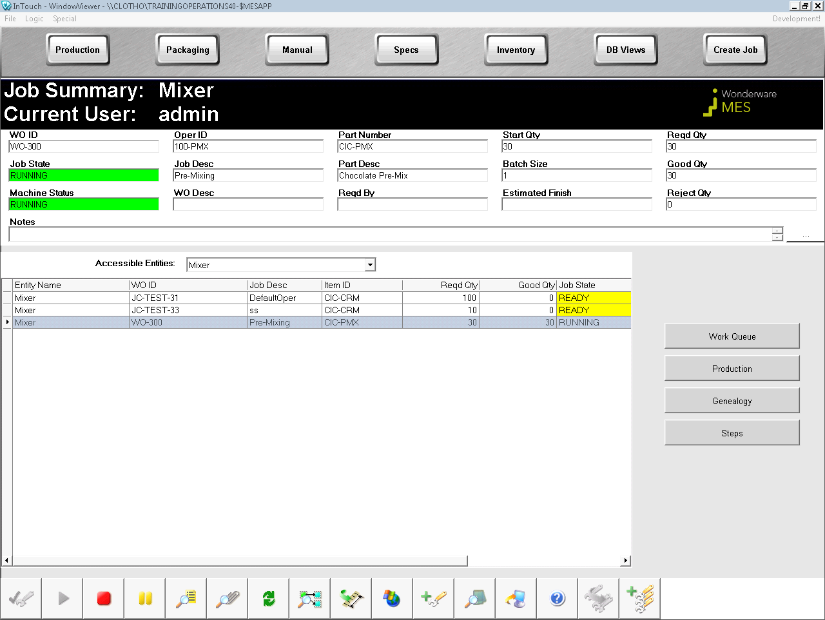
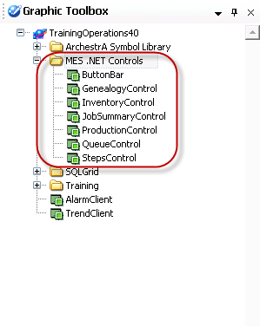
Lab 15 Using Wonderware MES .NET Controls
60 min

