Slide 1
DASIDIRECT
Communication

Slide 2
What is DASIDIRECT ?
The SIDirect DAServer is a Microsoft® Windows® application program that acts as a communications protocol server. It provides other Windows application programs with access to data within the
Siemens S7-200/300/400/1200 family of PLCs. The Industrial Application Server DAServer provides access to a Siemens PLC through an off-the-shelf standard Ethernet network interface card in the computer.

Slide 3
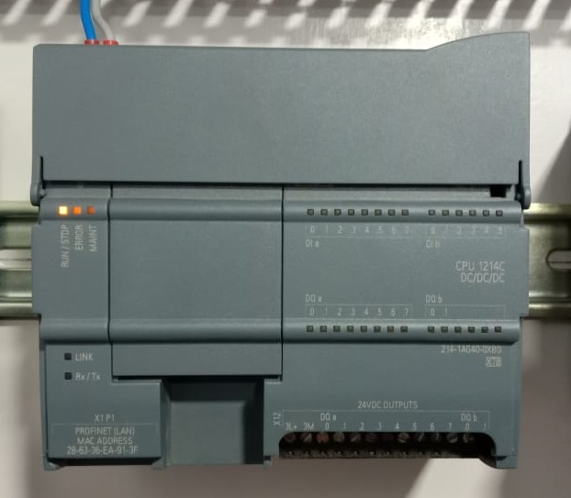
Data Flow FOR DASIDirect
Process
WW Clients (Intouch/Archetra) can take data only in DDE/Suitelink protocol.
WW Clients (Intouch/Archetra) can not take data directly from PLC so we use SMC.
Which can take data from PLC using DASIDIRECT protocol and give data to WWClients in Suitelink Protocol.
Simence s7 1214C
DASSIDIRECT
LAN
WWClient
Suitelink
SMC

Slide 4
Installing DASSIDiRECT
You will find installer of the DASSIDIRECT From 192.168.10.31 Server.
Installation is easy it does not require any further explanation

Slide 5
Configuring DASSIDiRECT to communicate with Simence s7 1214C
Navigate to OI- Default Group and Archetra DASSIDIRECT
Add PortCPS7 Object

Slide 6
Configuring DASSIDiRECT to communicate with Simence s7 1214C
Add PortCPS7 Object

Slide 7
Configuring DASSIDiRECT to communicate with Simence s7 1214C
Add S7Cp Object
If we are using PLC model less than model S7 200then add S7Cp_200 Object.
If we are using PLC model Greater than model S7 200then add S7Cp_Object

Slide 8
Configuring DASSIDiRECT to communicate with Simence s7 1214C
Add IP Address
Add Device Group AND Device Item

Slide 9
Configuring DASSIDiRECT to communicate with Simence s7 1214C
Now SMC Configuration is done.
1. Open WW Client
2. Create Connection with Node localhost, Application DASSIDIRECT
And topic same which is defined in SMC
Select Connection Type IOT.
3. Connect it
4. Add Same item which is defined in SMC.
5. Now you will get data in wwclients.

