Slide 1
7
Inventory Management

Slide 2
Wonderware MES 4.0 - Operations
Module 7:
Inventory Management
Contents
Section 1: Inventory
Lab 19 – Managing Inventory Lots
Lab 20 – Tracking Job Inventory Updates

Slide 3
Storage Exec Attributes
Attribute | Receive | Move | Reclassify
ToLocation | Yes | Yes | Yes
ToItem | Yes | Yes | Yes
ToLot | Yes | Yes | Yes
ToGrade | Yes | Yes | Yes
ToState | Yes | Yes | Yes
ToExpiryDate | Yes | Yes | Yes
ToUnitofMeasure | Yes | Yes | Yes
TransferQuantity | Yes | Yes | Yes
TransferOption |  | Yes
FromLocation |  | Yes | Yes
FromItem |  | Yes | Yes
FromLot |  | Yes | Yes

Slide 4
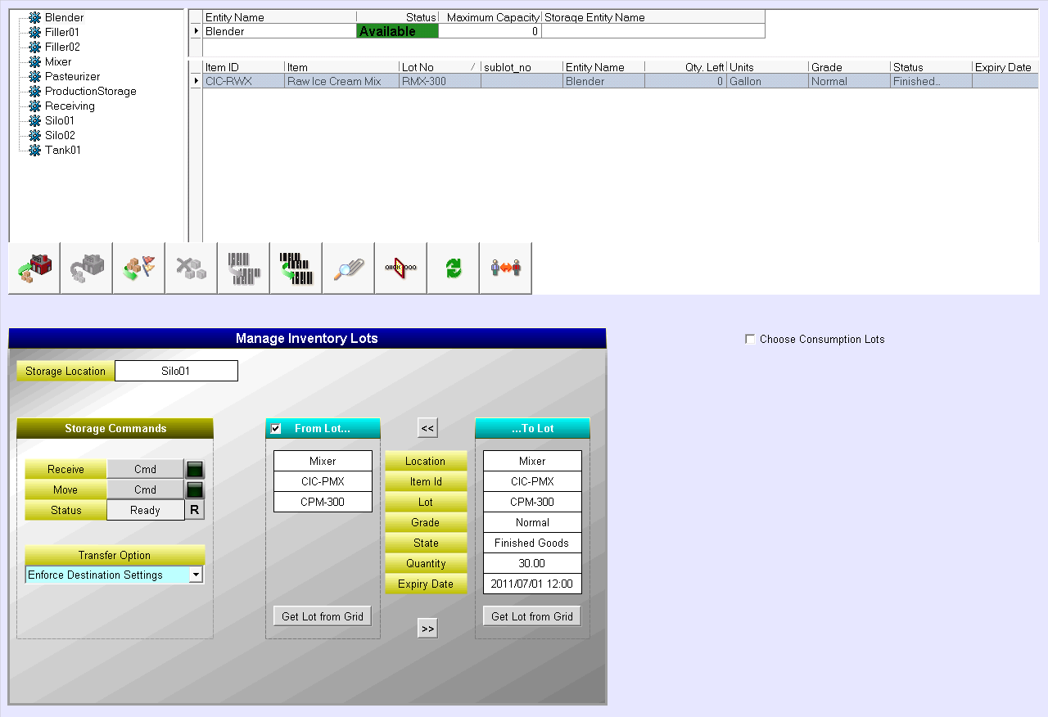
Lab 19 Managing Inventory Lots
30 min

Slide 5
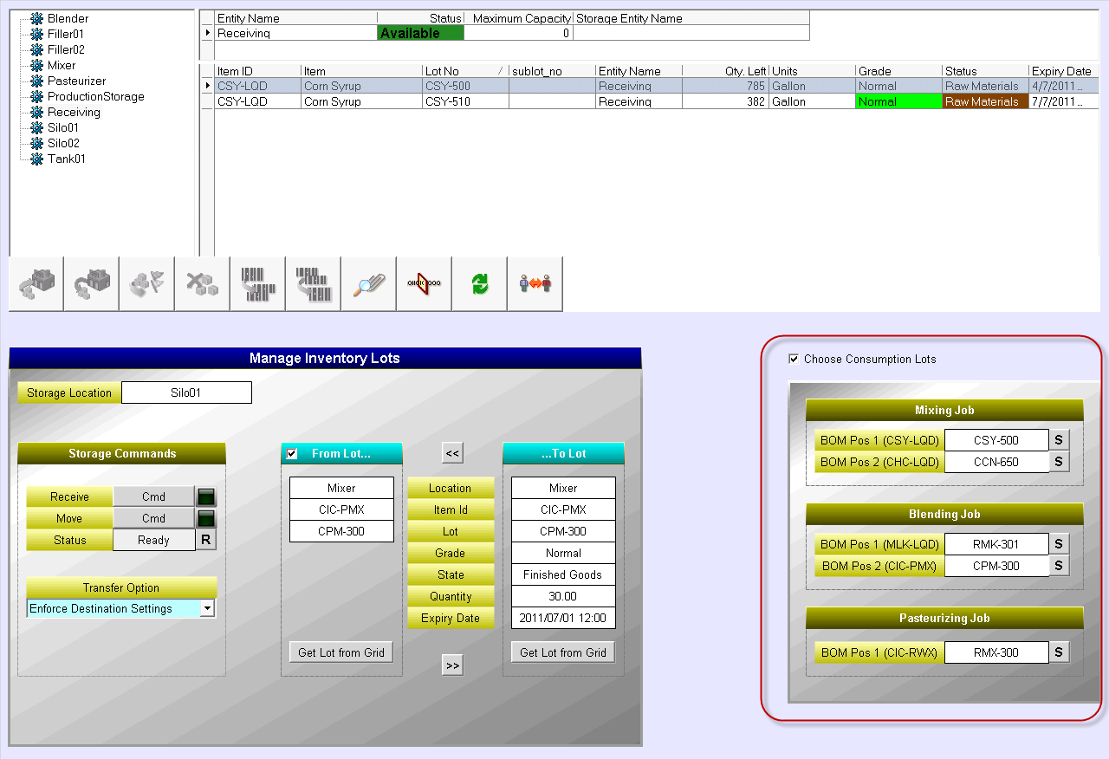
Lab 20 Tracking Job Inventory Updates
30 min

