Slide 1
ABT System – RTMS (Real Time Monitoring System)

Slide 2
Company Corporate Introduction
SSM Infotech Solutions Pvt. Ltd.
Know Us..
↓
Local
Intranet
Internet

Slide 3
Needs of ABT Regime
ABT says on low frequency, grid will give you more money if you generate more power.
ABT made our conventional monitoring systems obsolete.
Increasing emphasis on commercial aspects of plant operation.
Need to respond to needs of Operation Engineers in block-to-block decision making.

Slide 4
Salient features of ABT-RTMS
Displays all ABT parameters in real-time in Control Room i.e. “Ex-bus generation”, “Net gain” and break-ups of generation on Gas / Liquid fuels.
Display of Target Generation to assist decisions.
Generates audio / visual alarms for operator.
OPC-DA server for integration with other systems.
Specially designed trending application i.e. Forecast graph and scatter graph.
No Special scripting is required.

Slide 5
Salient features of ABT-RTMS
Energy schedule Import DC and SG in web application(Access in LAN network).
Web base interface for access ABT screen , reporting and configuration of ABT System.
ABT Main screen Shows Instantaneous values and average values of Required Parameter such as,
Avg Freq Avg AG MW Suggested MW Target MWh
Predicted MWh Expected Block Freq Predicted Freq UI MW & UI Rate
UI Rs & NetUI Rs Fuel Cost for Current 15 min Block and Previous Block.
ABT Detail screen Calculate cumulative data up to previous block like,
AG MW Over Inject MWh & Rs
Over Inject Deviation Cap Rs Diff. Deviation Cap Rs
Over Injection Rate in Rs Under Injection MWh
Additional Deviation in Rs Under Injection in Rate Rs
Total Receivable Deviation in Rs

Slide 6
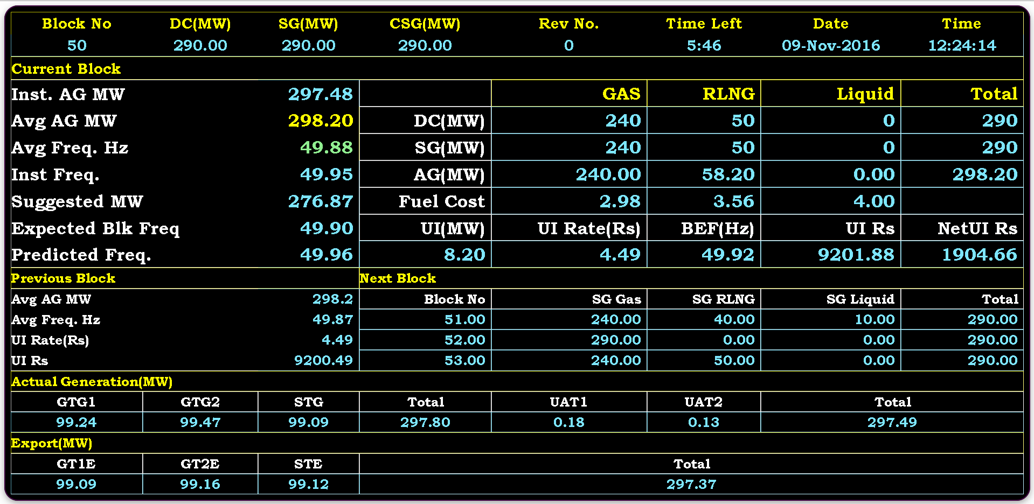
ABT Main Screen

Slide 7
ABT 4th DSM Amendment
Major Changes in DSM 4th Amendment
Frequency Band has been tightened to 50.05 to 49.85
Deviation Price Vector linked to Daily Average Area Cleaning Price(ACP) in Day Ahead Market of Power Exchange.
Cap Rate For all Generator.
In the event of sustained deviation from SG in one direction (positive or negative) by any regional entity , such regional entity shall have to change sign of their deviation from schedule, at least once, after every 6 time blocks.
Calculation 1% Deviation During Day

Slide 8
ABT 4th DSM Amendment
Major Changes in DSM 4th Amendment
Deviation Price Vector linked to Daily Average Area Cleaning Price(ACP) in Day Ahead Market of Power Exchange
In the event of sustained deviation from SG in one direction (positive or negative) by any regional entity , such regional entity shall have to change sign of their deviation from schedule, at least once, after every 6 time blocks
Penalty for Continue sustain deviation
Day deviation for 1% During Day
Cap Rate Generator
Pfactor Calculate by Equitation Given by DSM Regulations

Slide 9
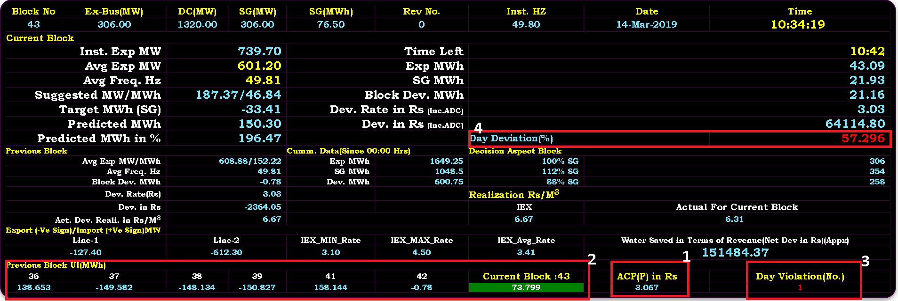
ABT Main Screen

Slide 10
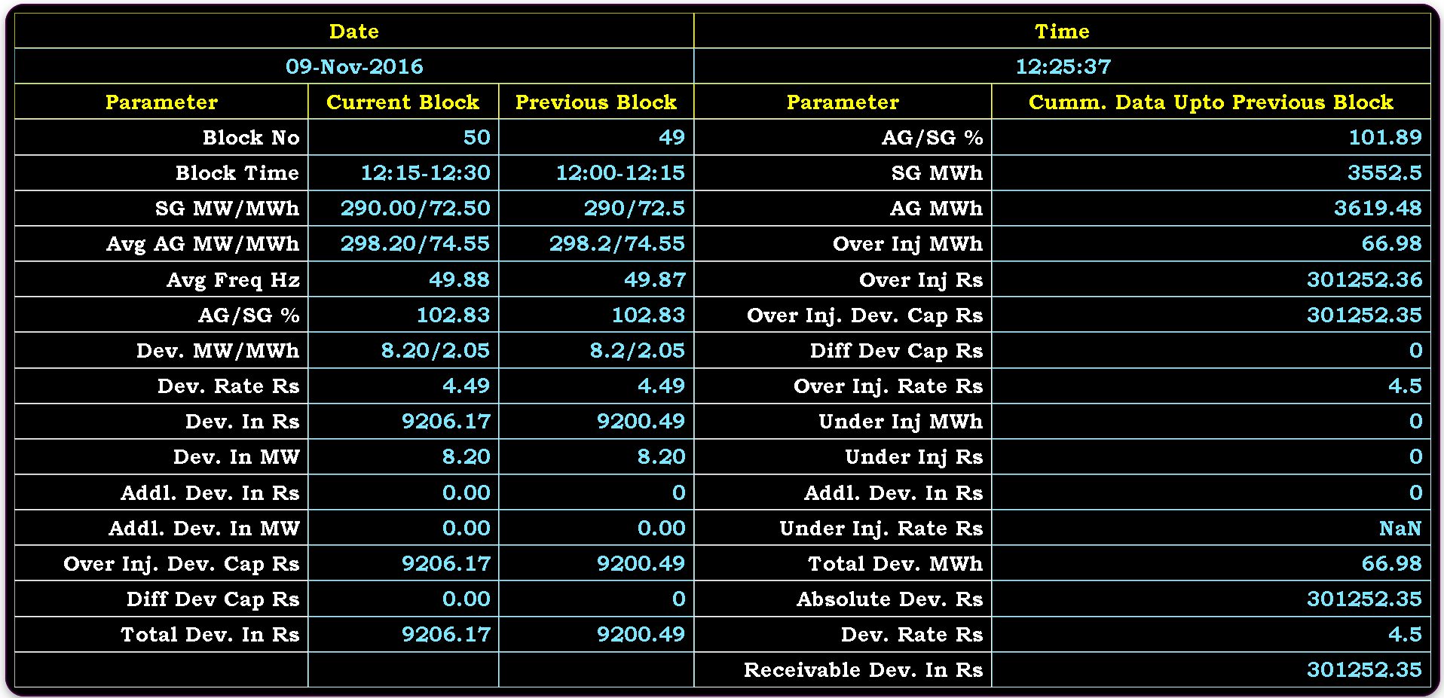
ABT Detail Screen

Slide 11
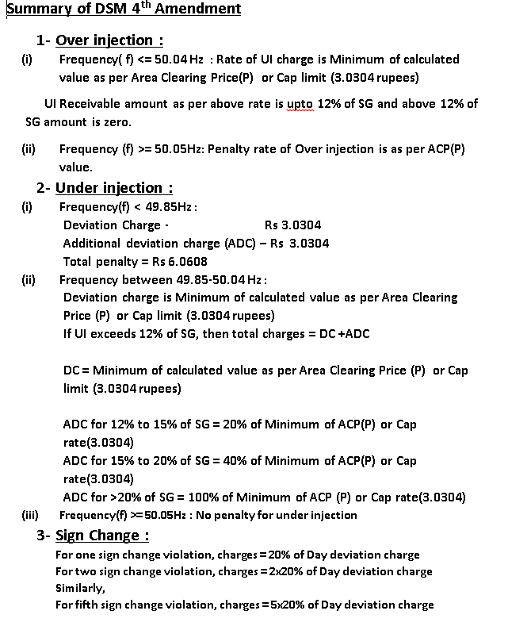
ABT Detail Screen Formulas

Slide 12
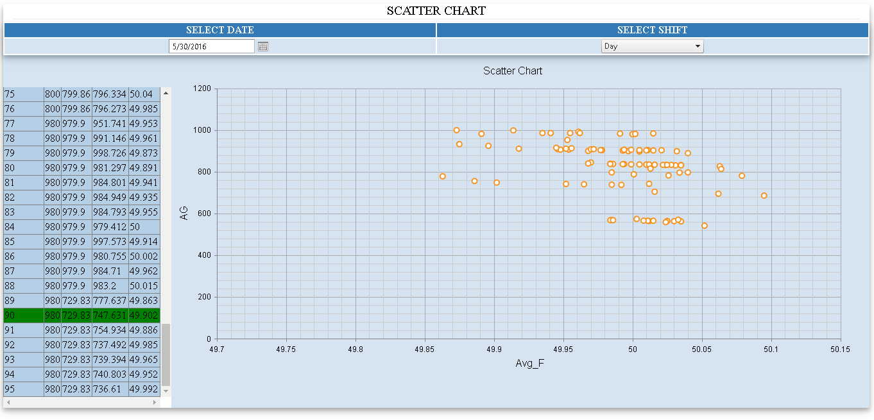
Scatter Chart

Slide 13
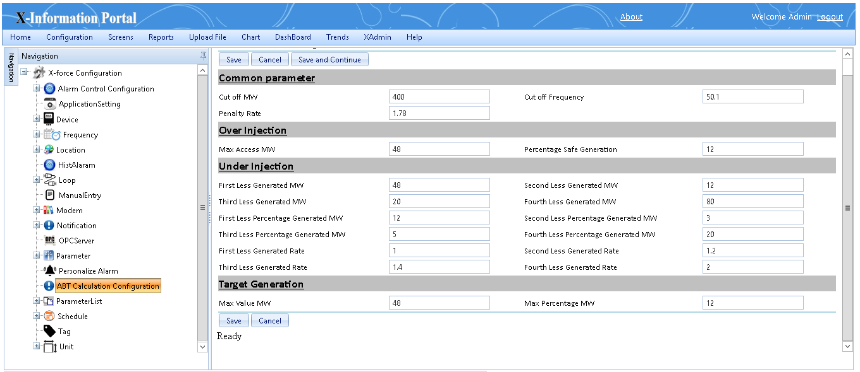
ABT Calculation Configuration

Slide 14
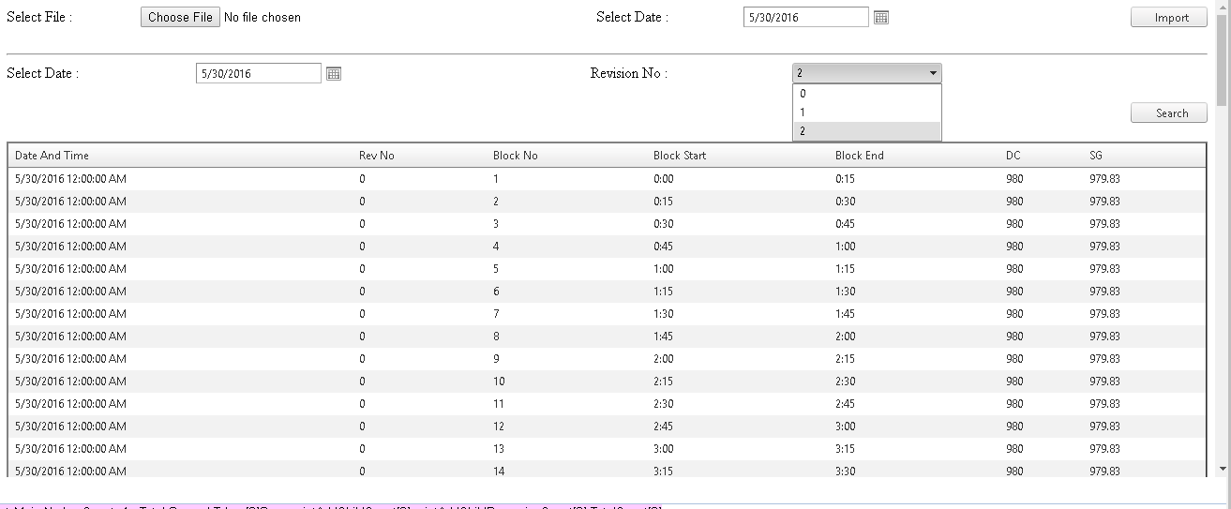
DC & SG Import

Slide 15
Daily Performance Report

Slide 16
Features of Server Application
Connect with Modbus, Ethernet or OPC compliance meters
Configuration of fuels, combine cycle, fuel cost with applicable date time
Calculation of Heat Rate, forecast of cut off frequencies and target generation
Specially design for ABT system

Slide 17
SSM Infotech Solutions Pvt. Ltd.
Thank you
Have a nice day…

