Slide 1
4
Integration with MES/Operations

Slide 2
MES 2012 - Quality
Module 4:
Integration with MES/Operations
Contents
Section 1: MES/Operations
Lab 10 – Building and Running a Basic Operation
Section 2: Sample Plan Integration with Operations
Lab 11 – Creating and Running the Box Weights Sample Plan
Notes:
This is the agenda for the Module.
It lists all the sections and labs for the module.

Slide 3
MES Software
MES / Quality is one component of MES software
MES / Performance
Provides a software solution for collecting, tracking and communicating real-time equipment performance and efficiency information
MES / Operations
Powerful WIP management using queue controls, business logic and multilevel BOM features
Monitoring accurate ‘planned vs. actual’ production using intuitive user interfaces
Operational enforcement using procedural steps

Slide 4
MES / Operations and Quality
MES / Quality can integrate with MES / Operations
Sample generation on Job states
Job Start
Job End
Process must be configured prior to MES / Quality

Slide 5
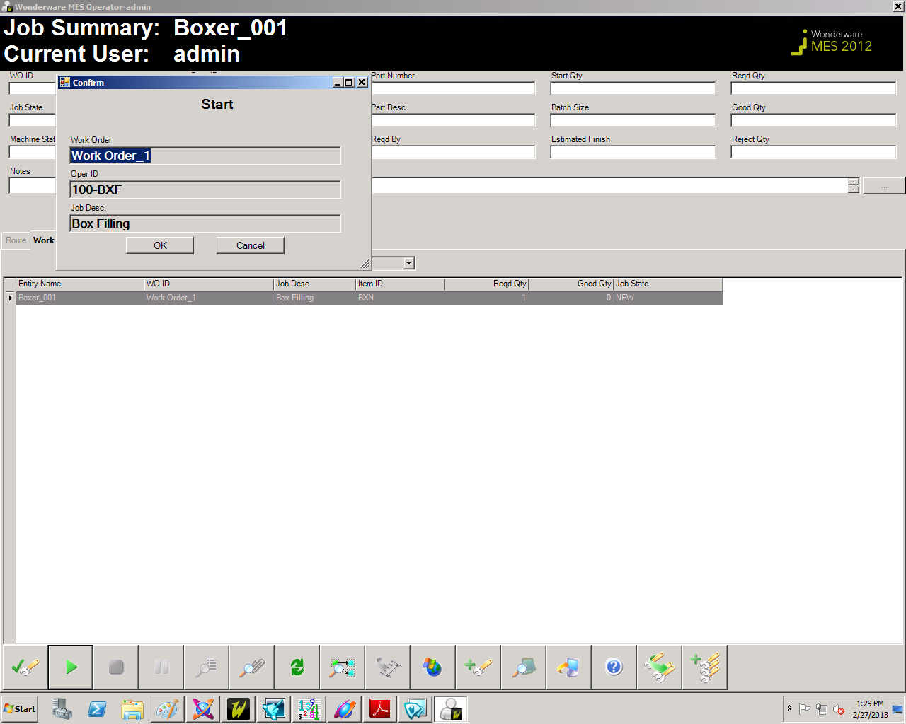
Lab 10 Building a Basic Operation
25 min

Slide 6
MES / Operations and Quality
Sample Plan Frequency Definition
Sample generation on Job states
Job Start
Sample is generated when the job starts
Job End
Sample is generated when the job ends

Slide 7
MES / Operations and Quality
QM Specification Definition
Process and Operation selection
Link to the specific operation that must start/end for the sample to generate

Slide 8
Lab 11 Creating and Running the Box Weights Sample Plan
35 min

