Slide 1
MES 2012 - Performance
Module 6:
Visualization
Contents
Section 1: Visualization Overview
Section 2: Importing .NET Controls for Performance
Lab 10: Using Utilization Controls Lab 11: Using OEE Controls

Slide 2
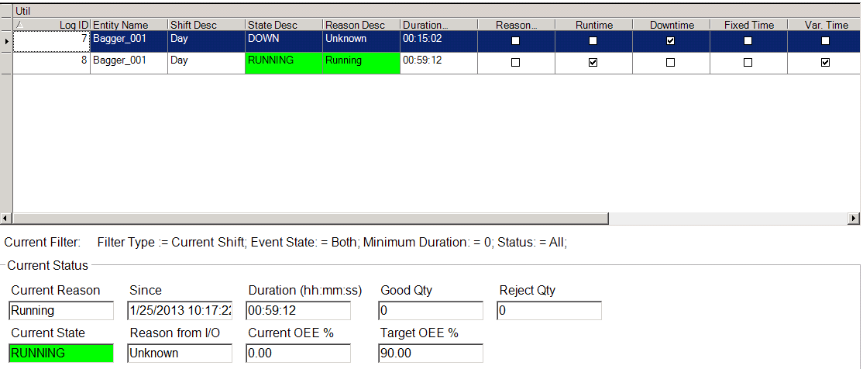
MES .NET Client Controls
File
FactMES.Controls.JobSummary
File
FactMES.Controls.Utilization
File
Fact.Controls.ButtonBar

Slide 3
MES Controls for Performance
Fact.Controls.ButtonBar.dll
FactMES.Controls.CountsOrDurationControl.dll
FactMES.Controls.JobSummary.dll
FactMES.Controls.OEEKPIControl.dll
FactMES.Controls.ProductionProgressControl.dll
FactMES.Controls.Utilization.dll

Slide 4
Linking Button Bar and Another MES Client Control
Control: C1
Control: C2
C1.ButtonBarName = B1
C2.ButtonBarName = B1
Button Bar: B1
B1.ControlInCharge = C2
B1.ShowAllControlsButton = False

Slide 5
Linking Button Bar and Another MES Client Control
Control: C1
Control: C2
C1.ButtonBarName = B1
C2.ButtonBarName = B1
Button Bar: B1
B1.ControlInCharge = C2
B1.ShowAllControlsButton = True
B1.ShowAllControlsButton = False

Slide 6
Lab 10 Using Utilization Controls
Lab Introduction
15 min
In this lab, you will:
Embed Utilization and Button Bar client controls in an ArchestrA Graphic and configure the controls
Construct an InTouch window by embedding the ArchestrA graphic

Slide 7
Lab 11 Using OEE Controls
Lab Introduction
20 min
In this lab, you will:
Embed OEE client controls in an ArchestrA graphic and configure the controls
Construct an InTouch window by embedding the ArchestrA graphic
Monitor the production progress

